Slide 1
LBBDr User Group
Session 2 – Exploratory Data Analysis
Presented by: Michael Sinclair

Slide 2
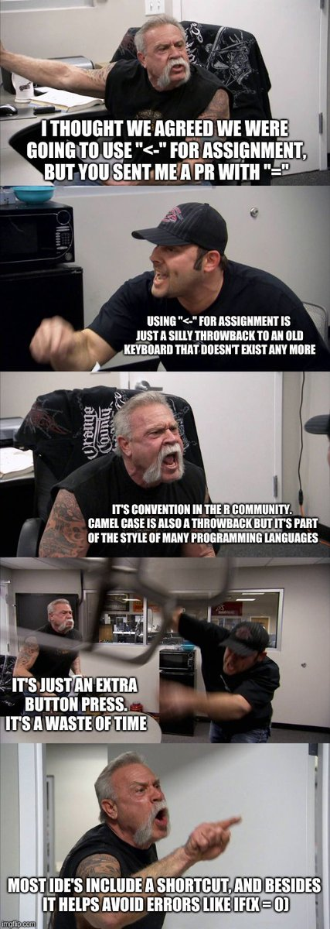

Slide 3
Session Outline
What is Exploratory Data Analysis
Why should we do it
Segway: Correlation
Summary Statistics
Calculating correlation
Exploring data visually

Slide 4
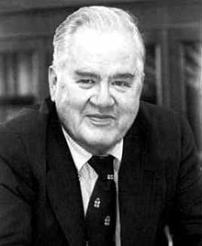
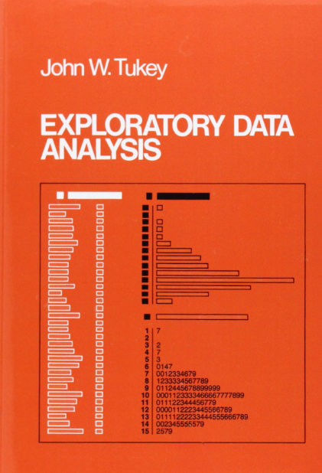
In statistics, exploratory data analysis (EDA) is an approach to analysing data sets to summarize their main characteristics, often with visual methods.
Exploratory data analysis was promoted by John Tukey to encourage statisticians to explore the data, and possibly formulate hypotheses that could lead to new data collection and experiments.
EDA is different from initial data analysis (IDA) which focuses more narrowly on checking assumptions required for model fitting and hypothesis testing, and handling missing values and making transformations of variables as needed. EDA encompasses IDA.

Slide 5
What is EDA
Exploratory Data Analysis allows us to see our data, start to understand their shape and identify patterns, trends and abnormalities
“a picture paints a thousand words”
Frederick R. Barnard in Printer's Ink (December, 1921)

Slide 6
Techniques
Box plot
Run Chart
Histogram
Scatter plot
Dimensionality Reduction
Principal Component Analysis (PCA)
Multidimensional scaling
Chernoff Faces
In session 1 we create a box plot to explore our data visually and identified that we had an extreme outlier
This session we will focus on scatter plots as a way of comparing two variables
Notes:
A run chart, also known as a run-sequence plot is a graph that displays observed data in a time sequence. Often, the data displayed represent some aspect of the output or performance of a manufacturing or other business process. It is therefore a form of line chart.

Slide 7
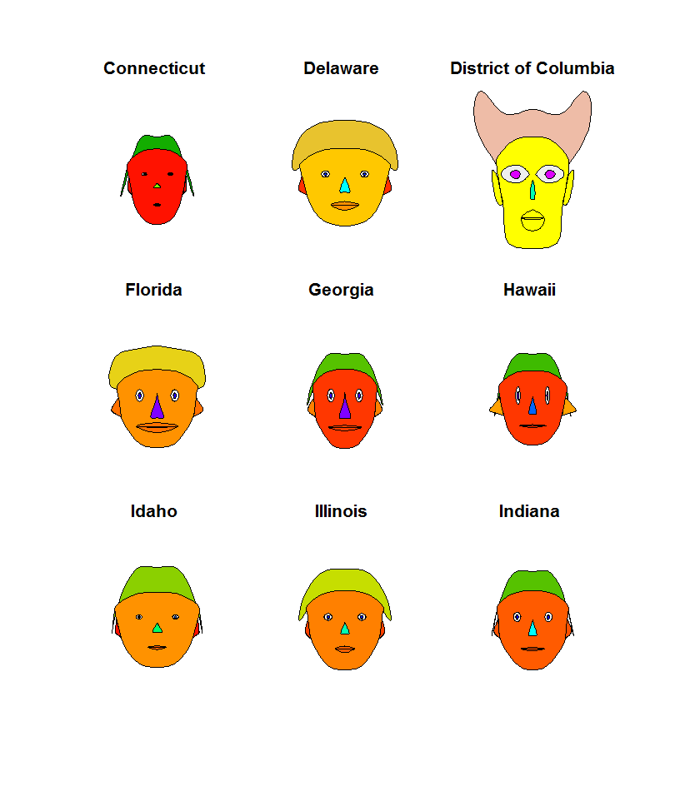
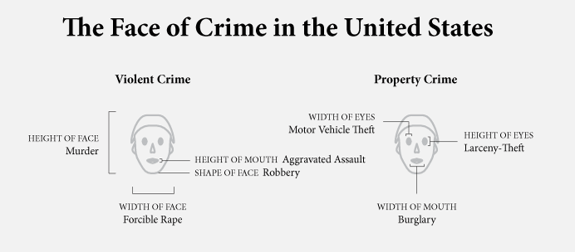
Chernoff Faces
https://flowingdata.com/2010/08/31/how-to-visualize-data-with-cartoonish-faces/
Notes:
https://flowingdata.com/2010/08/31/how-to-visualize-data-with-cartoonish-faces/

Slide 8
Why is EDA important?
...make both calculations and graphs. Both sorts of output should be studied; each will contribute to understanding.
F. J. Anscombe, 1973 (and echoed in nearly all talks about data visualization...)

Slide 9
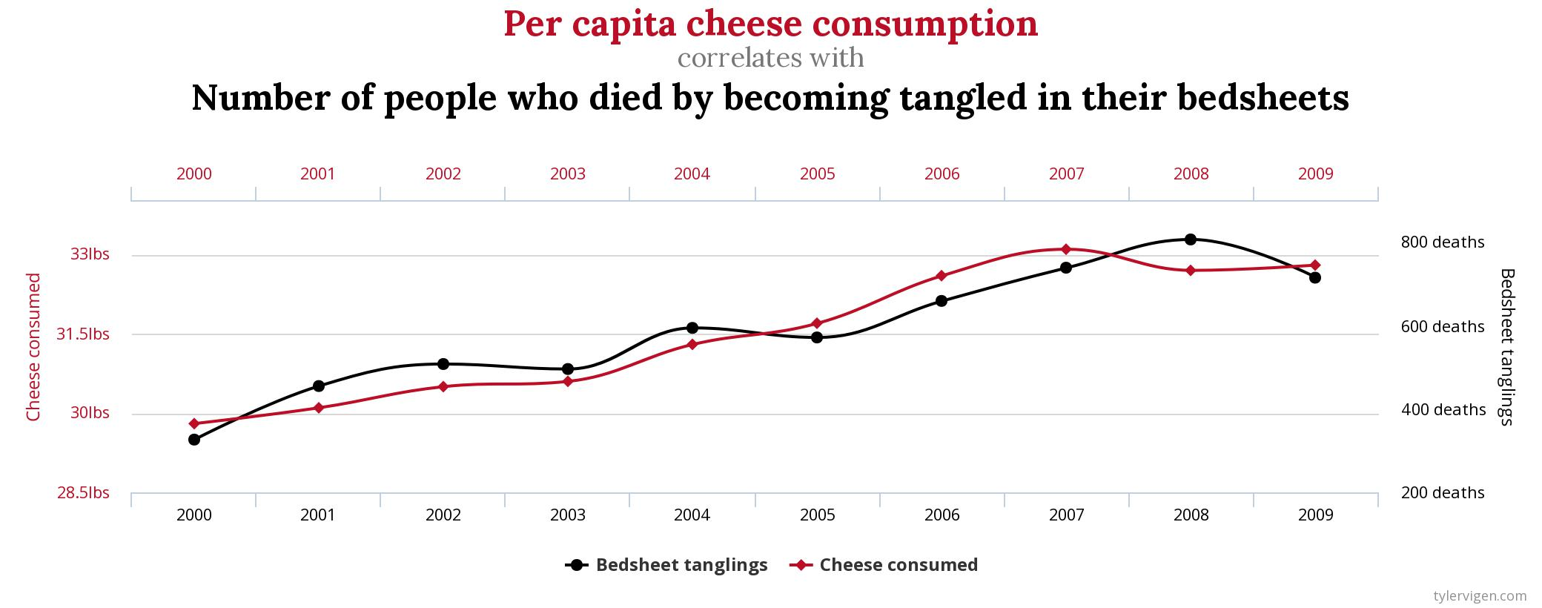
Spurious Correlations

Slide 10
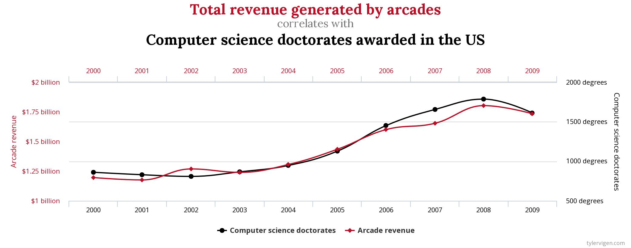
Spurious Correlations

Slide 11
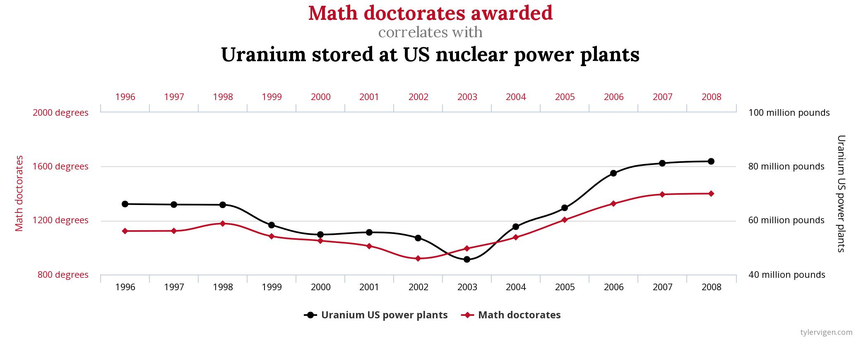
Spurious Correlations

Slide 12
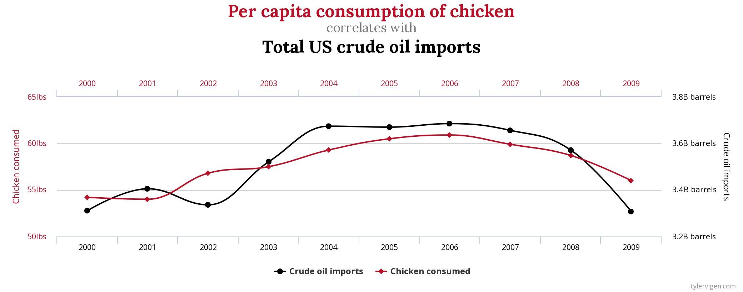
Spurious Correlations

